Slide 1


ENTERPRISE NETWORK DESIGN & IMPLEMENTATION USING HUAWEI DATACOM TECHNOLOGIES

Slide 2
1-NADA YEHIA YEHIA SHIHA
2-ALI MOHAMMED SAAD ALI
3-MOHAMMED MAAROUF MOHAMMED
4-MUHAMMED FAISAL MASOUD JUWAIDA
5-MAHMOUD FATHY HASSAN
GRADUATION PROJECT – DEPI
NETWORK INFRASTRUCTURE TRACK
SUPERVISOR: ENG. MOHAMED NAFEA

Slide 3
PROJECT OBJECTIVE
Design and implement a full enterprise network using
Huawei Datacom technologies, including Access,
distribution, and Core layers.
The goal is to build a scalable, secure, and fully functional network supporting LAN and WAN operations.

Slide 4
PROJECT SCOPE
THIs project covers four main phases:
Week 1: Network fundamentals, physical topology design, and device inventory.
Week 2: Layer 2 & Layer 3 configuration (VLANs, STP, Inter-VLAN Routing, IP addressing, Static Routes, OSPF).
Week 3: WAN & Security setup (PPP/PPPoE, NAT, ACLs, AAA).
Week 4: Network services & optimization (DHCP, DNS, SNMP, IPv6) + Documentation.

Slide 5
DELIVERABLES
Network topology
Configuration files
Testing screenshots
Final documentation
Final presentation

Slide 6
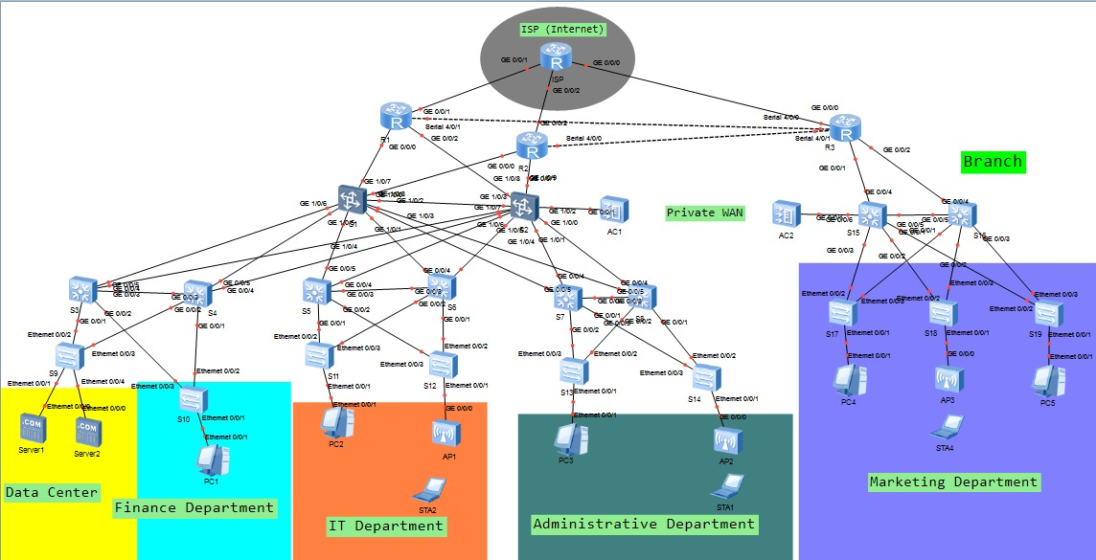
NETWORK TOPOLOGY

Slide 7
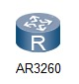
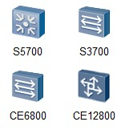




DEVICES USED
ROUTERS: AR3260
SWITCHES:
CE12800
AC6605
S5700
S3700
ACCESS POINT : AP2050
PCs
STAs

Slide 8
DELIVERABLES
PHYSICAL topology diagram
Logical topology diagram (VLANs + IP Subnets)
Device inventory list

Slide 9
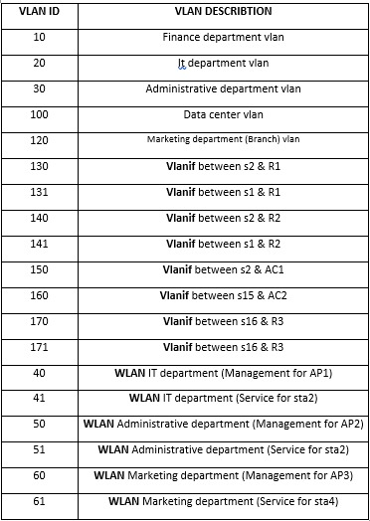
LAYER 2 CONFIGURATION – WEEK 2
VLANS

Slide 10
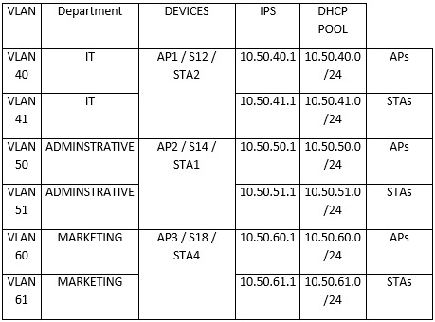
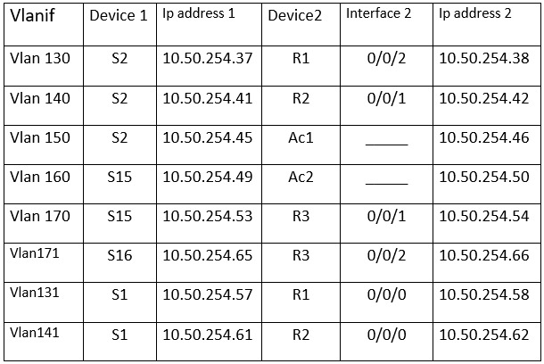
LAYER 2 CONFIGURATION – WEEK 2
VLANS

Slide 11
ACCESS / TRUNK PORTS:
ALL END DEVICES PORTS ARE SET TO ACCESS.
PORTS CONNECTING SWITCH-TO-SWITCH ARE SET TO TRUNK.
VLAN 1 IS DISABLED ON TRUNK PORTS FOR SECURITY REASONS.

Slide 12
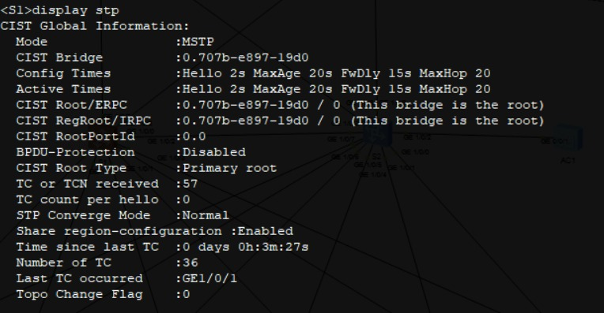
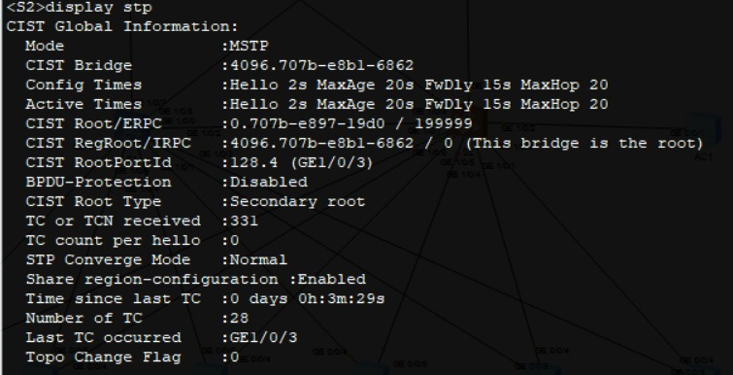
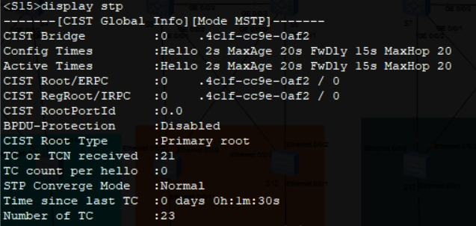
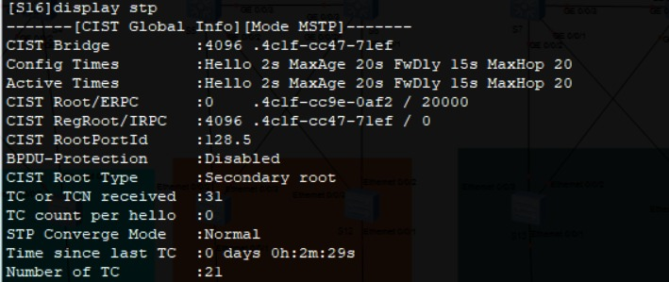
STP (SPANNING TREE PROTOCOL):

Slide 13
INTER-VLAN ROUTING:
Configured vlanif on Layer 3 Switch for each VLAN
Enabled routing between VLANs
Verified connectivity using Ping
VLAN ID:-
131,Vlanif between s1 & R1
140,Vlanif between s2 & R2
141,Vlanif between s1 & R2
150,Vlanif between s2 & AC1
160,Vlanif between s15 & AC2
131,Vlanif between s1 & R1
140,Vlanif between s2 & R2
141,Vlanif between s1 & R2
150,Vlanif between s2 & AC1
160,Vlanif between s15 & AC2
170,Vlanif between s16 & R3
171,Vlanif between s16 & R3
10,Vlanif
20,Vlanif
30,Vlanif
100 vlanif
120vlanif

Slide 14
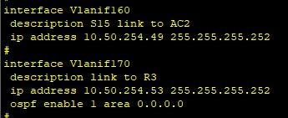
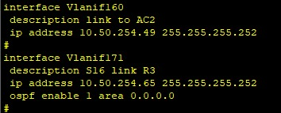
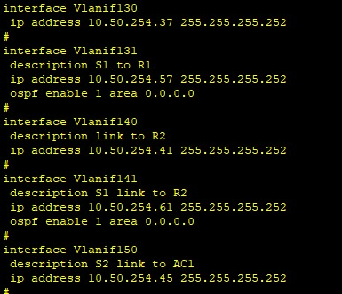
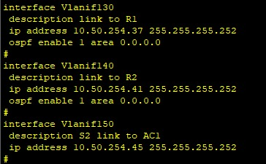
INTER-VLAN ROUTING:

Slide 15
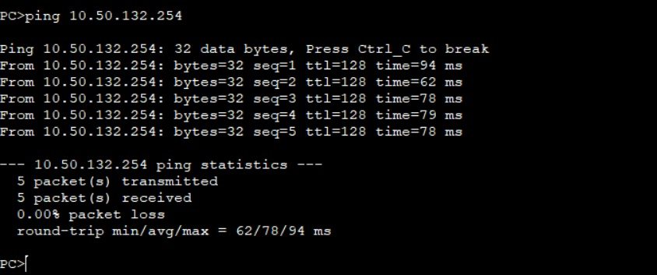
PING TESTS BETWEEN SAME VLANS:
ping same vlan pc4 to pc5

Slide 16
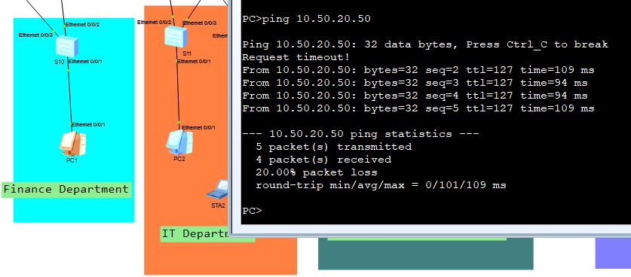
PING TESTS BETWEEN DIFFERENT VLANS:
ping pc1 to pc2

Slide 17
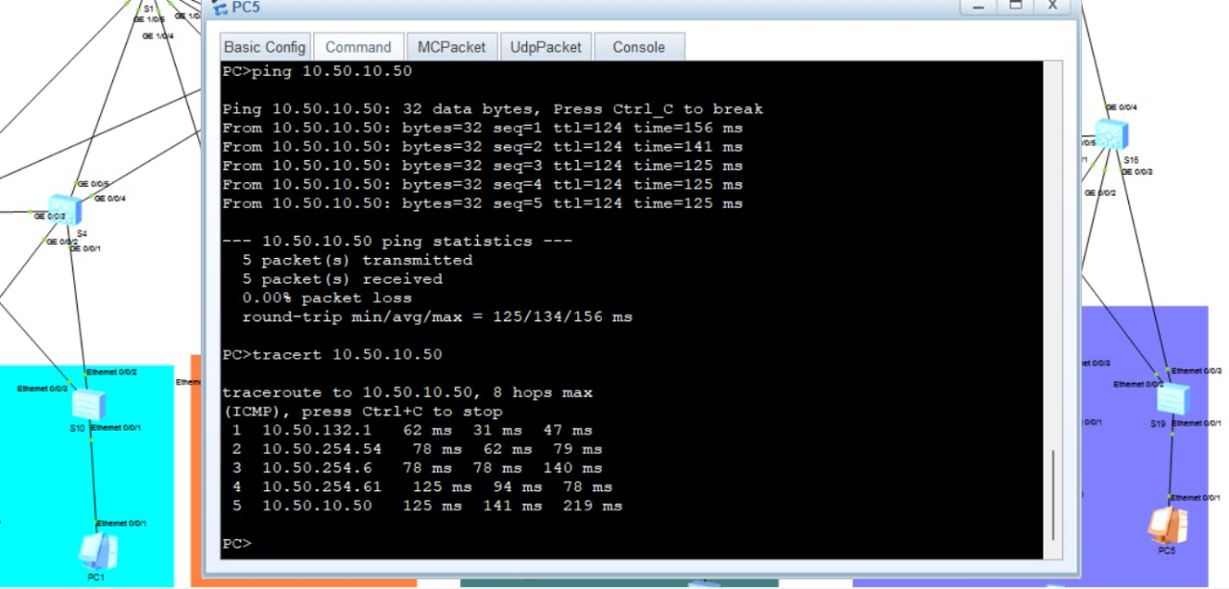
PING TESTS BETWEEN DIFFERENT LANS:
ping pc5 to pc1

Slide 18
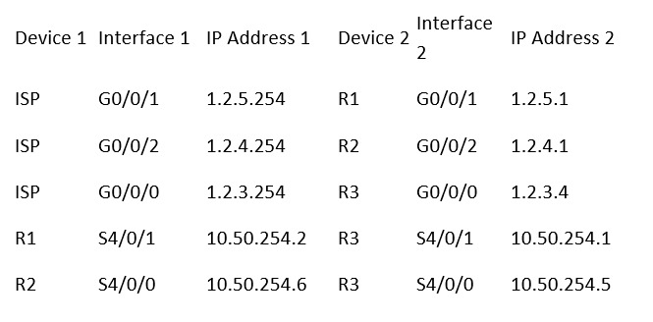
LAYER 3 CONFIGURATION:
IP Addressing Plan assigned for all VLANs

Slide 19
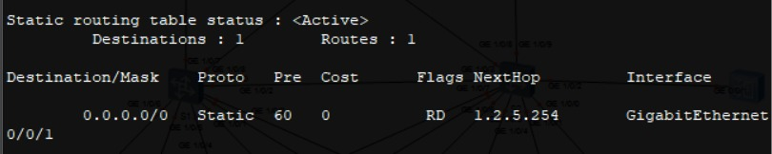
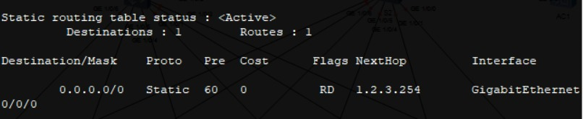
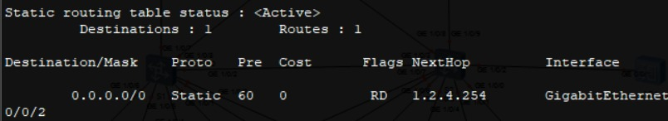
LAYER 3 CONFIGURATION:
Configured Static Routes for external networks

Slide 20
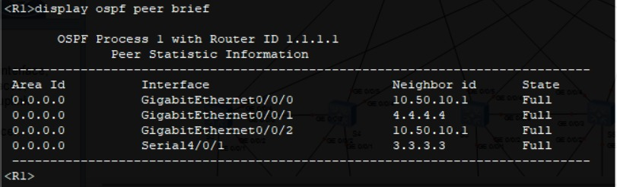
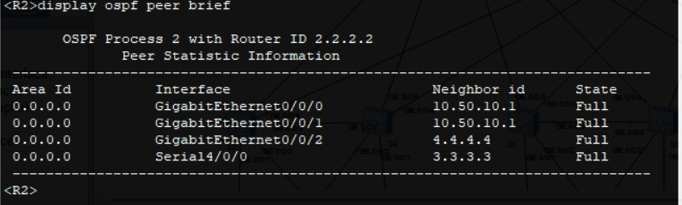
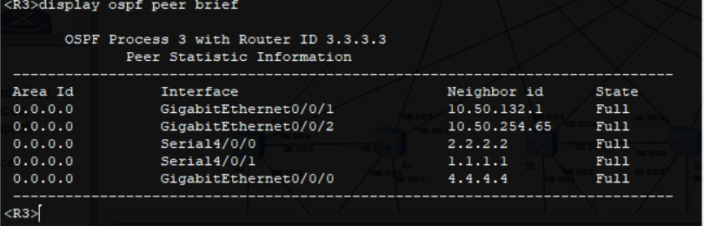
LAYER 3 CONFIGURATION:
Implemented OSPF for dynamic routing
R1
R2
R3

Slide 21
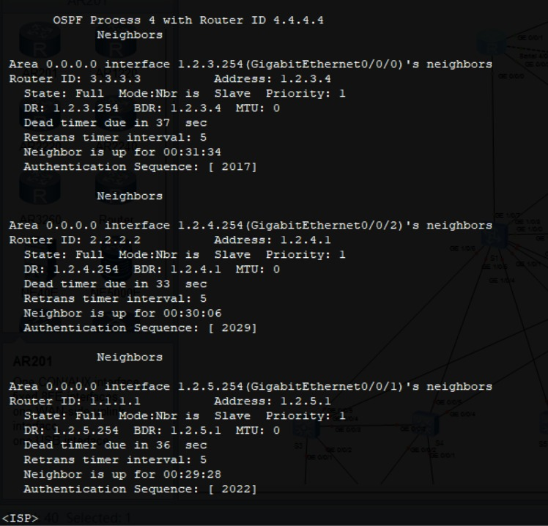
LAYER 3 CONFIGURATION:
Verified OSPF neighbors and routing table
ospf peer on isp

Slide 22
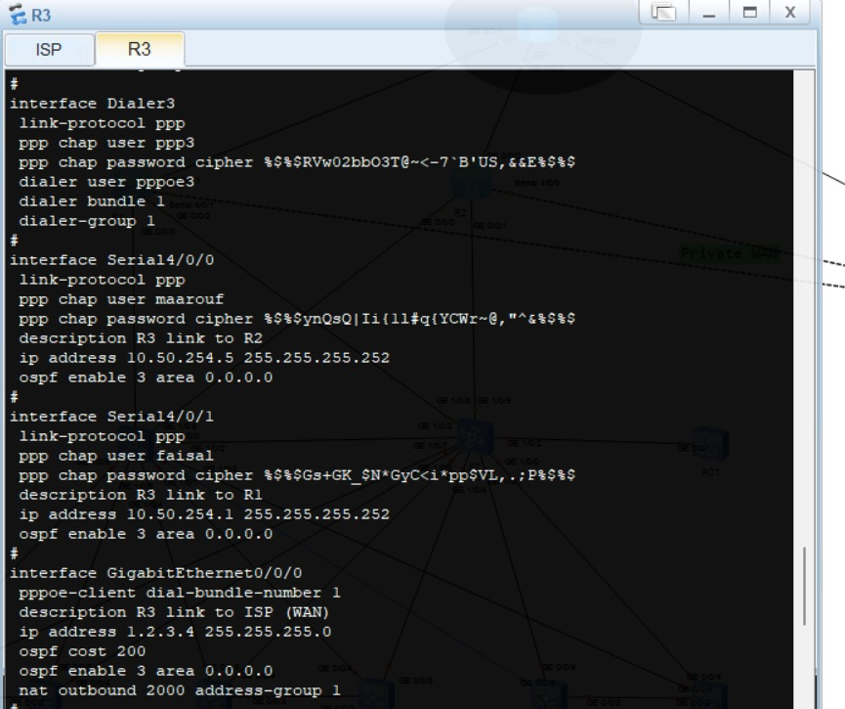
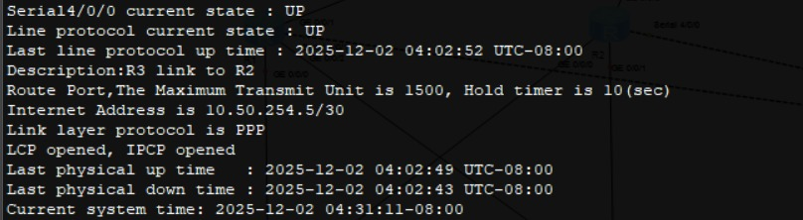
WAN & Security
Configured PPP/PPPoE for WAN connections

Slide 23
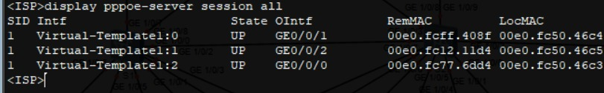
WAN & Security
Verified connectivity with PPPoe sessions,

Slide 24
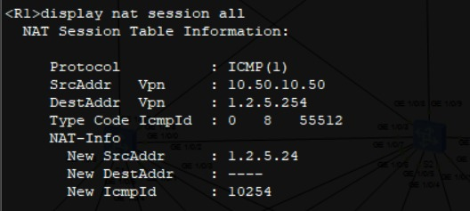
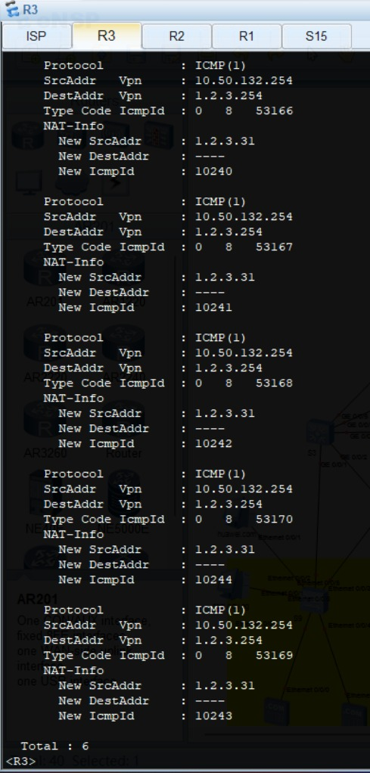
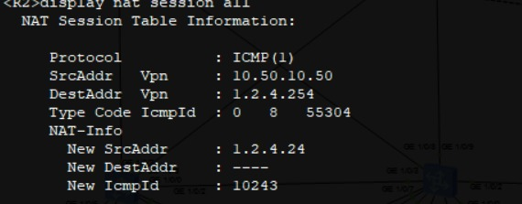
WAN & Security
Implemented NAT (inside/outside)
R1
R2

Slide 25
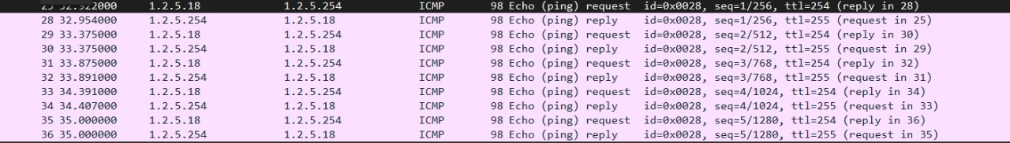
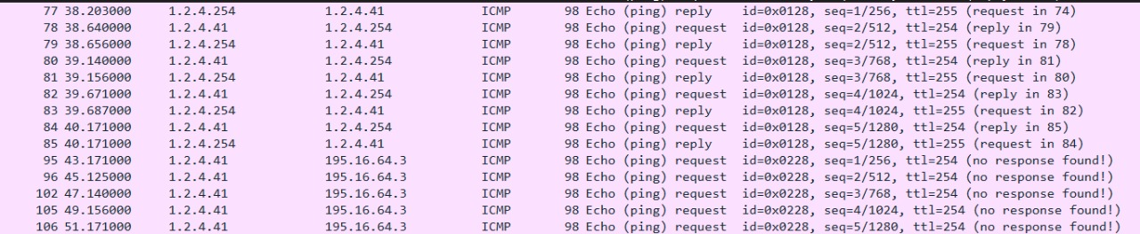
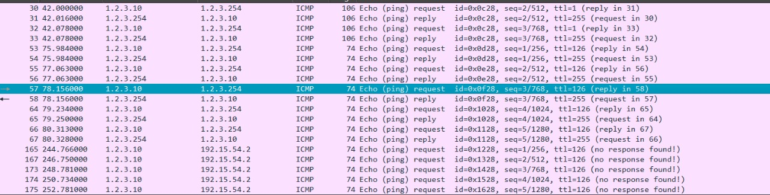
WAN & Security
Implemented NAT
R1 nat
R2 nat
R3 nat

Slide 26
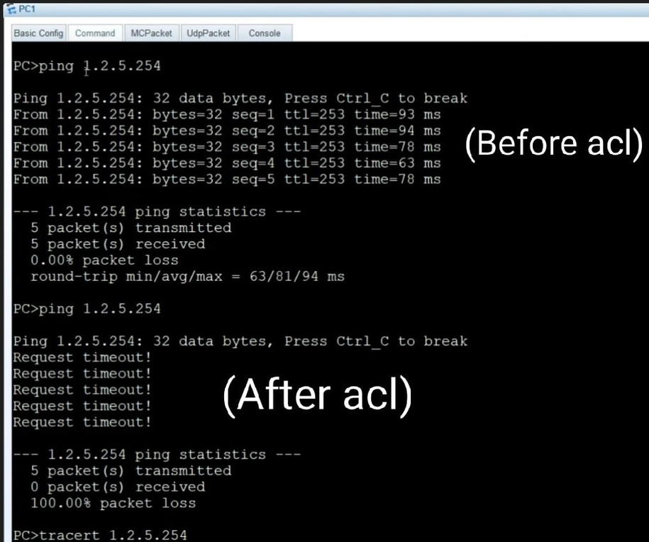
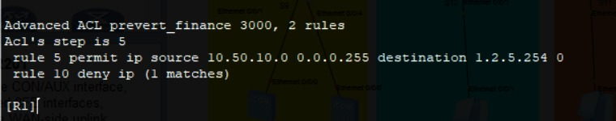
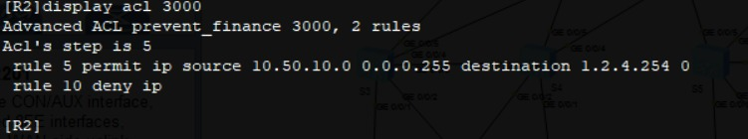
WAN & Security
Created ACLs to control traffic
(prevent finance department to access internet)
R1
R2

Slide 27
WAN & Security
Slide – AAA (Authentication, Authorization, Accounting)
Bullets:
Authentication:
Verifies the identity of the user before accessing the network.
Authorization:
Determines what the authenticated user is allowed to do (permissions & access levels).
Accounting:
Tracks user activities such as login time, commands used, and session duration.
Our Implementation in the Project:
Configured AAA to secure device access.
Used local user accounts for authentication and authorization.

Slide 28
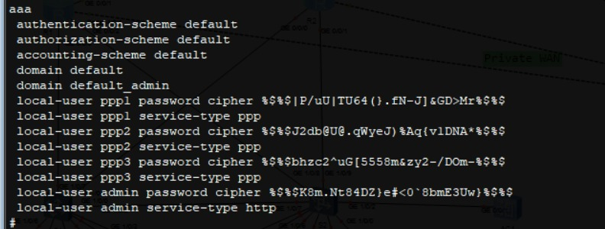
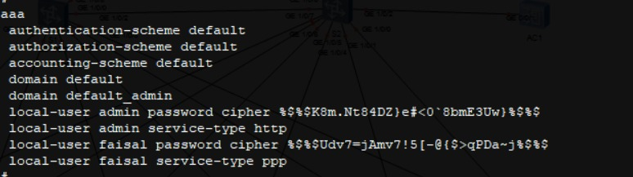
WAN & Security
Slide – AAA (Authentication, Authorization, Accounting)
ISP
R1

Slide 29
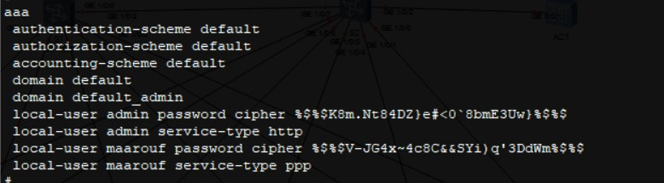
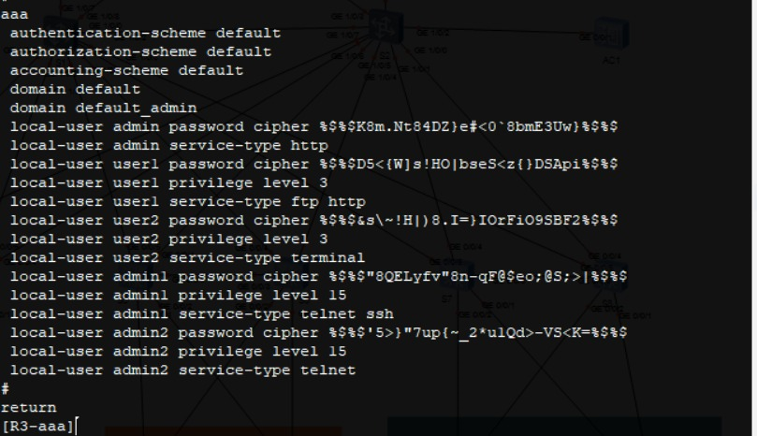
WAN & Security
Slide – AAA (Authentication, Authorization, Accounting)
R2
R3

Slide 30
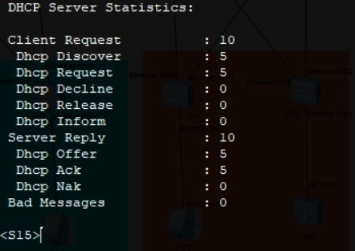
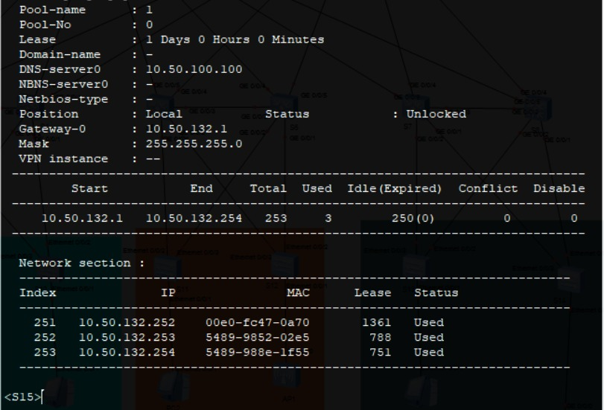
NETWORK Services:
Configured DHCP pool

Slide 31
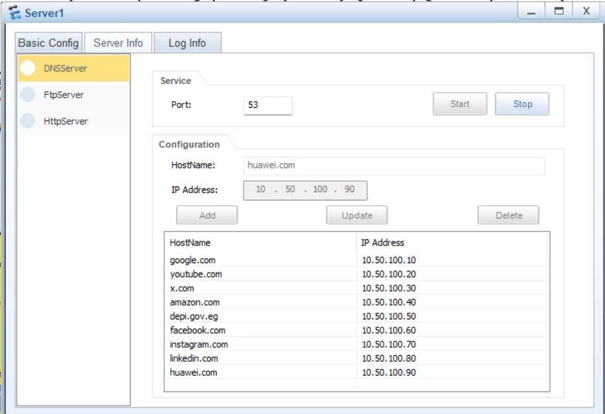
NETWORK Services:
Set up DNS for name resolution

Slide 32
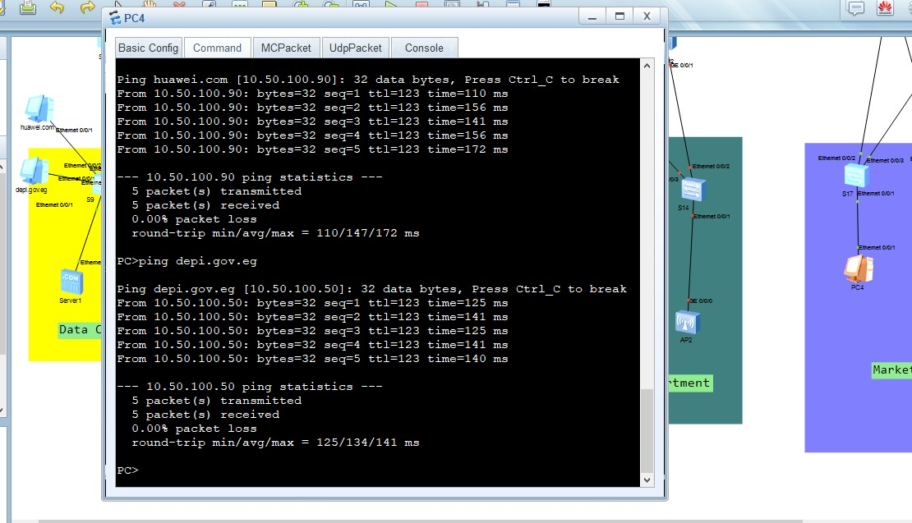
NETWORK Services:
Verified connectivity and service functionality

Slide 33
NETWORK Services:
Implemented SNMP for network monitoring
A protocol for remote network monitoring and management.
Allows monitoring device performance (Routers, Switches) and receiving alerts for network issues.
Uses Community Strings to control access (Read-only / Read-Write).
Can collect data such as CPU usage, Memory, Interface Status, Traffic.
Note: SNMP was not implemented practically in our project; this is a theoretical overview.

Slide 34
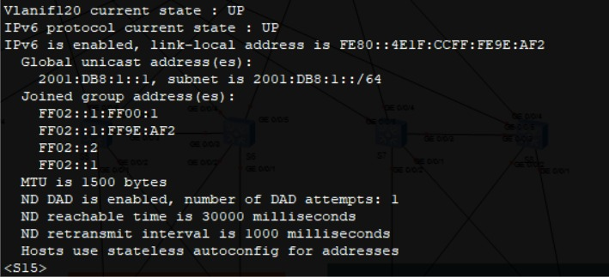
NETWORK Services:
Configured basic IPv6 addressing
ipv6 on S15

Slide 35
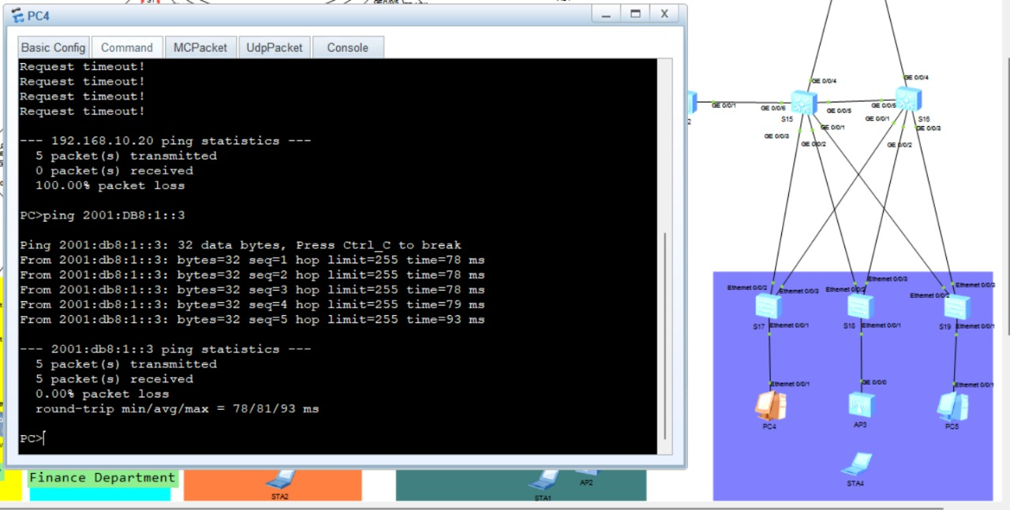
NETWORK Services:
Verified connectivity and service functionality
ping pc4 to pc5 ipv6

Slide 36
CHALLENGES & Solutions
-PPPoe Issue:
Some routers we used did not support PPPoe.
Solution: Replaced the router with another model that supports PPP.
Lesson Learned: Always check router capabilities before configuration.
-nating issue
-wlan

Slide 37
FINAL RESUlts
Network fully functional: All VLANs and routing working correctly
High availability: Redundant links and devices configured
Secure access: VLANs segmented and ACLs implemented
Services running smoothly: DHCP, DNS, NAT, and Inter-VLAN routing verified
Optimized performance: Connectivity tests passed and OSPF areas designed efficiently

Slide 38
Thank You

